Slide 1
Algorithm Analysis and Design Recurrence Equation (Solving Recurrence using Iteration and Recursion Tree Methods) Week 3 Lecture – 7

Slide 2
Overview
A recurrence is a function is defined in terms of
one or more base cases, and
itself, with smaller arguments.
Examples:

Slide 3
Overview
Many technical issues:
Floors and ceilings
[Floors and ceilings can easily be removed and don’t affect the solution to the recurrence. They are better left to a discrete math course.]
Exact vs. asymptotic functions
Boundary conditions

Slide 4
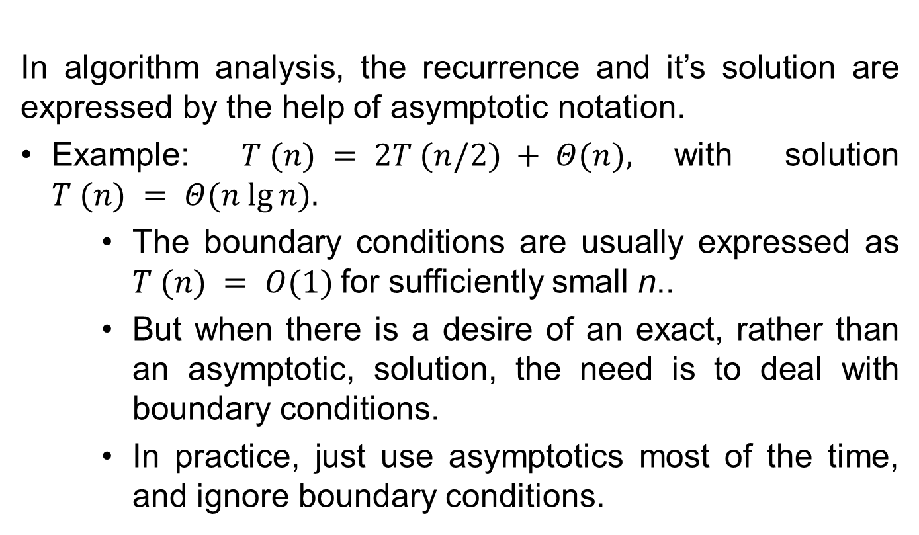
Overview
In algorithm analysis, the recurrence and it’s solution are expressed by the help of asymptotic notation.
Example: $T (n) = 2T (n/2) + Θ(n),$with solution $T (n) = Θ(n lg⁡n).$
The boundary conditions are usually expressed as $T (n) = Ο(1)$for sufficiently small n..
But when there is a desire of an exact, rather than an asymptotic, solution, the need is to deal with boundary conditions.
In practice, just use asymptotics most of the time, and ignore boundary conditions.

Slide 5
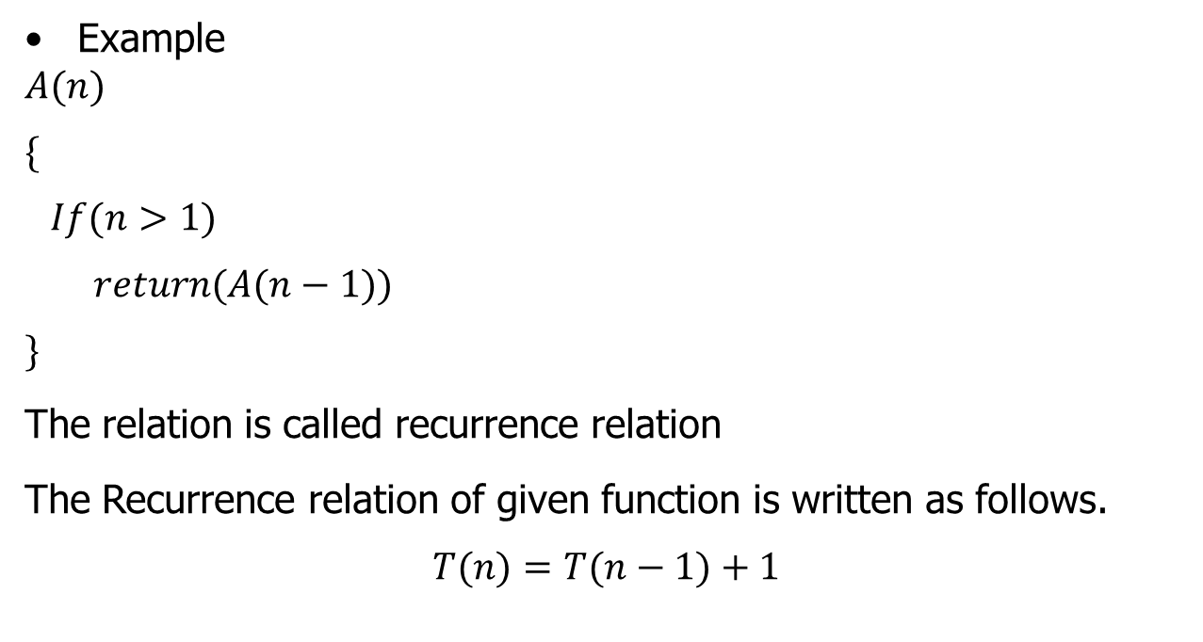
Recursive Function
Example
$$A(n)$$
$$\{$$
$$If(n>1)$$
$$return(A(n−1))$$
$$\}$$
The relation is called recurrence relation
The Recurrence relation of given function is written as follows.
$$T(n)=T(n−1)+1$$

Slide 6
Recursive Function
To solve the Recurrence relation the following methods are used:
Iteration method
Recursion-Tree method
Master Method
Substitution Method

Slide 7
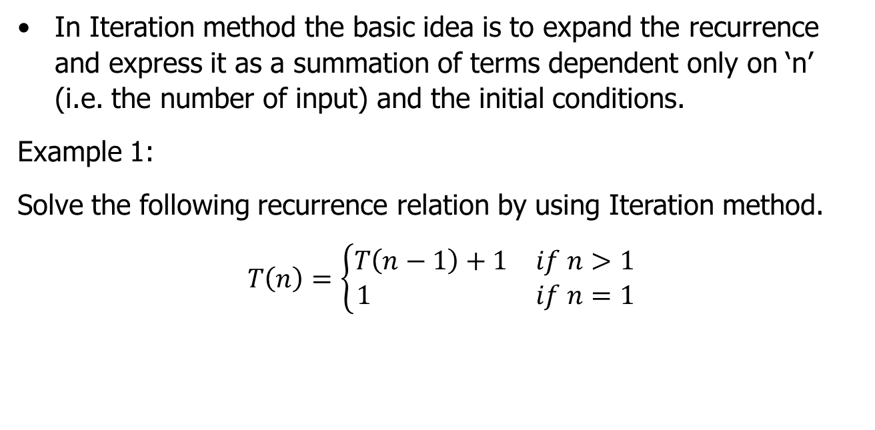
Iteration Method( Example 1)
In Iteration method the basic idea is to expand the recurrence and express it as a summation of terms dependent only on ‘n’ (i.e. the number of input) and the initial conditions.
Example 1:
Solve the following recurrence relation by using Iteration method.
$$T\left(n\right)=\left\{\begin{matrix}T\left(n−1\right)+1 & if n>1 \\ 1 & if n=1\end{matrix}\right.$$

Slide 8
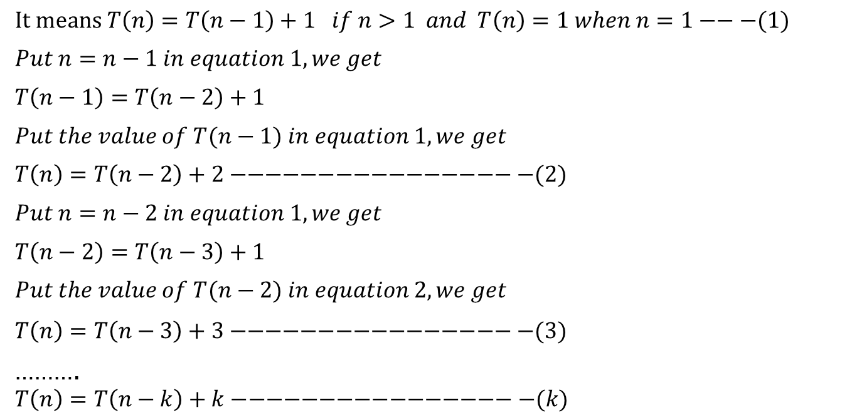
Iteration Method ( Example 1)
$It means T\left(n\right)=T\left(n−1\right)+1 if n>1 and T\left(n\right)=1 when n=1−−−(1)$
$$Put n=n−1 in equation 1, we get$$
$$T\left(n−1\right)=T\left(n−2\right)+1$$
$$Put the value of T(n−1) in equation 1, we get$$
$$T\left(n\right)=T\left(n−2\right)+2−−−−−−−−−−−−−−−−−(2)$$
$$Put n=n−2 in equation 1, we get$$
$$T\left(n−2\right)=T\left(n−3\right)+1$$
$$Put the value of T(n−2) in equation 2, we get$$
$$T\left(n\right)=T\left(n−3\right)+3−−−−−−−−−−−−−−−−−(3)$$
……….
$$T\left(n\right)=T\left(n−k\right)+k−−−−−−−−−−−−−−−−−(k)$$

Slide 9
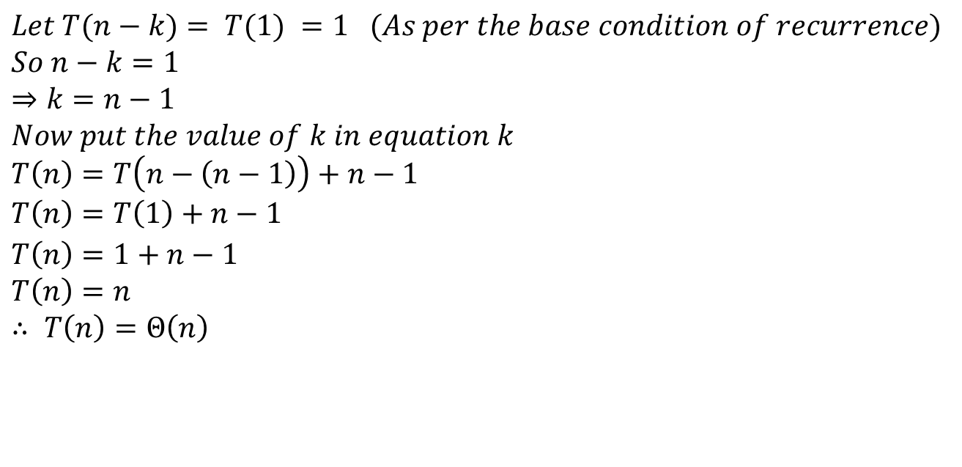
Iteration Method ( Example 1)
$$Let T(n−k)= T(1) =1 (As per the base condition of recurrence)$$
$$So n−k=1$$
$$⇒k=n−1$$
$$Now put the value of k in equation k$$
$$T\left(n\right)=T\left(n−\left(n−1\right)\right)+n−1$$
$$T\left(n\right)=T\left(1\right)+n−1$$
$$T\left(n\right)=1+n−1$$
$$T\left(n\right)=n$$
$$∴ T\left(n\right)=Θ\left(n\right)$$

Slide 10

Iteration Method ( Example 2)
Example 2:
Solve the following recurrence relation by using Iteration method.
$$T\left(n\right)=\left\{\begin{matrix}2T\left(\frac{n}{2}\right)+{3n}^{2} & if n>1 \\ 11 & if n=1\end{matrix}\right.$$

Slide 11
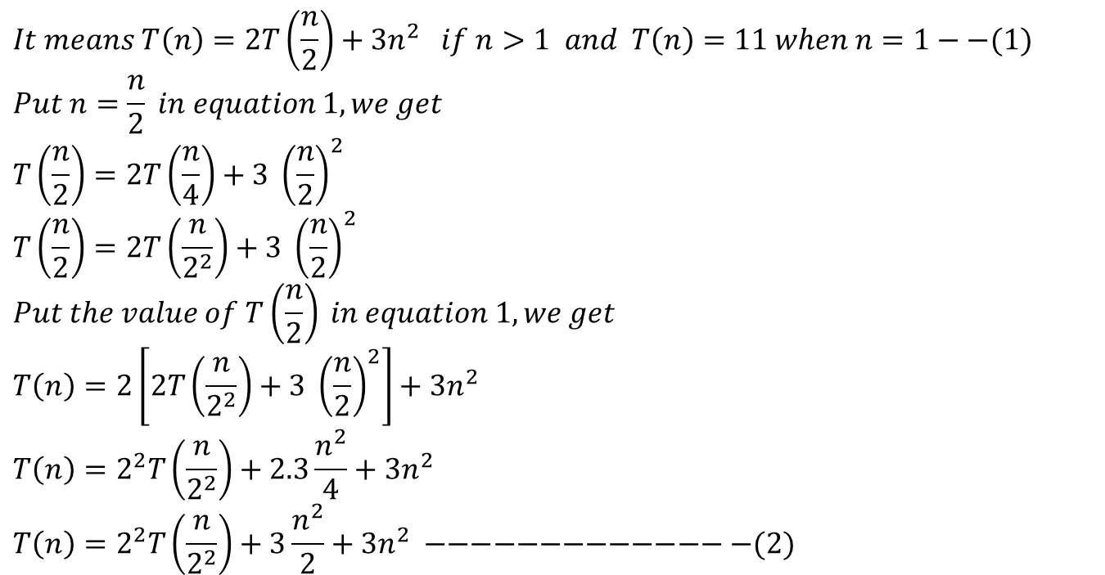
Iteration Method ( Example 2)
$$It means T\left(n\right)=2T\left(\frac{n}{2}\right)+{3n}^{2} if n>1 and T\left(n\right)=11 when n=1−−(1)$$
$$Put n=\frac{n}{2} in equation 1, we get$$
$$T\left(\frac{n}{2}\right)=2T\left(\frac{n}{4}\right)+3 {\left(\frac{n}{2}\right)}^{2}$$
$$T\left(\frac{n}{2}\right)=2T\left(\frac{n}{2^{2}}\right)+3 {\left(\frac{n}{2}\right)}^{2}$$
$$Put the value of T\left(\frac{n}{2}\right) in equation 1, we get$$
$$T\left(n\right)=2\left[2T\left(\frac{n}{2^{2}}\right)+3 {\left(\frac{n}{2}\right)}^{2}\right]+{3n}^{2}$$
$$T\left(n\right)=2^{2}T\left(\frac{n}{2^{2}}\right)+2.3\frac{n^{2}}{4}+{3n}^{2}$$
$$T\left(n\right)=2^{2}T\left(\frac{n}{2^{2}}\right)+3\frac{n^{2}}{2}+{3n}^{2} −−−−−−−−−−−−−−(2)$$

Slide 12
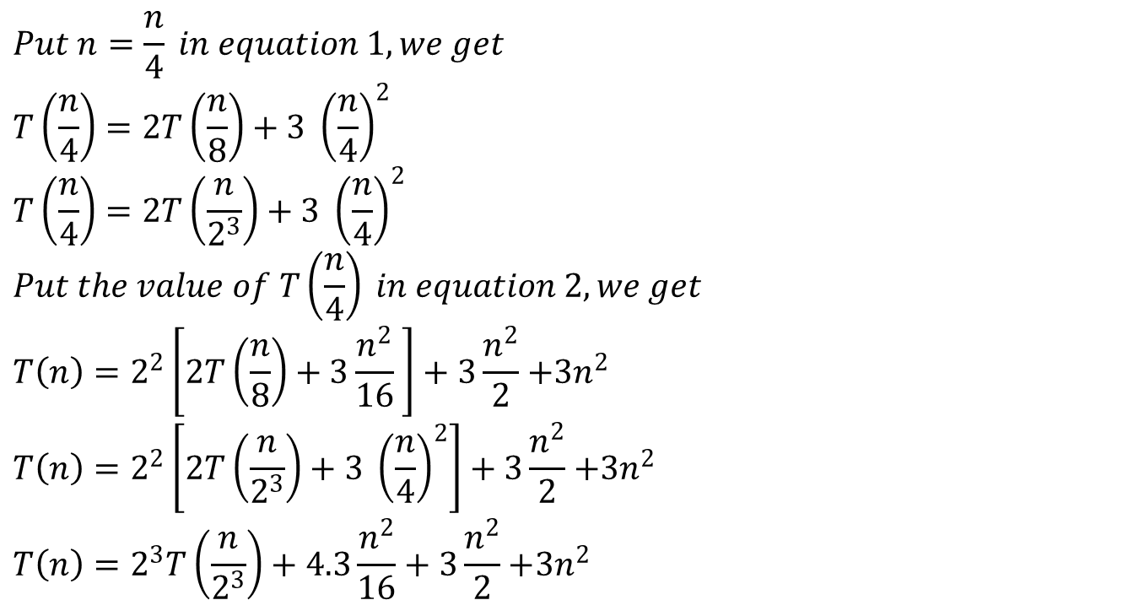
Iteration Method ( Example 2)
$$Put n=\frac{n}{4} in equation 1, we get$$
$$T\left(\frac{n}{4}\right)=2T\left(\frac{n}{8}\right)+3 {\left(\frac{n}{4}\right)}^{2}$$
$$T\left(\frac{n}{4}\right)=2T\left(\frac{n}{2^{3}}\right)+3 {\left(\frac{n}{4}\right)}^{2}$$
$$Put the value of T\left(\frac{n}{4}\right) in equation 2, we get$$
$$T\left(n\right)=2^{2}\left[2T\left(\frac{n}{8}\right)+3\frac{n^{2}}{16} \right]+3\frac{n^{2}}{2}{+3n}^{2}$$
$$T\left(n\right)=2^{2}\left[2T\left(\frac{n}{2^{3}}\right)+3 {\left(\frac{n}{4}\right)}^{2}\right]+3\frac{n^{2}}{2}{+3n}^{2}$$
$$T\left(n\right)=2^{3}T\left(\frac{n}{2^{3}}\right)+4.3\frac{n^{2}}{16}+3\frac{n^{2}}{2}{+3n}^{2}$$

Slide 13
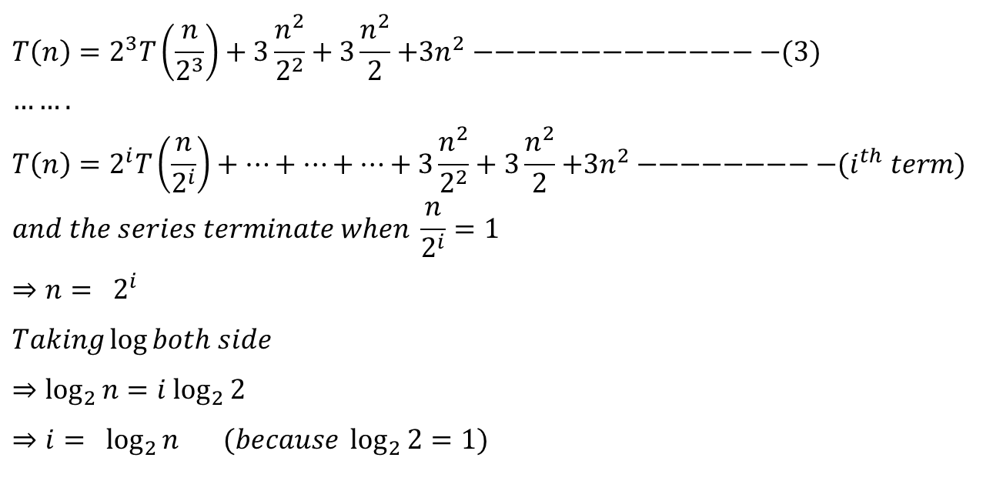
Iteration Method ( Example 2)
$$T\left(n\right)=2^{3}T\left(\frac{n}{2^{3}}\right)+3\frac{n^{2}}{2^{2}}+3\frac{n^{2}}{2}{+3n}^{2} −−−−−−−−−−−−−−(3)$$
$$…….$$
$$T\left(n\right)=2^{i}T\left(\frac{n}{2^{i}}\right)+…+…+…+3\frac{n^{2}}{2^{2}}+3\frac{n^{2}}{2}{+3n}^{2} −−−−−−−−−(i^{th} term)$$
$$and the series terminate when \frac{n}{2^{i}}=1$$
$$⇒n= 2^{i}$$
$$Taking\log{both side}$$
$$⇒\log_{2}{n}=i \log_{2}{2}$$
$$⇒i= \log_{2}{n} (because \log_{2}{2}=1)$$

Slide 14
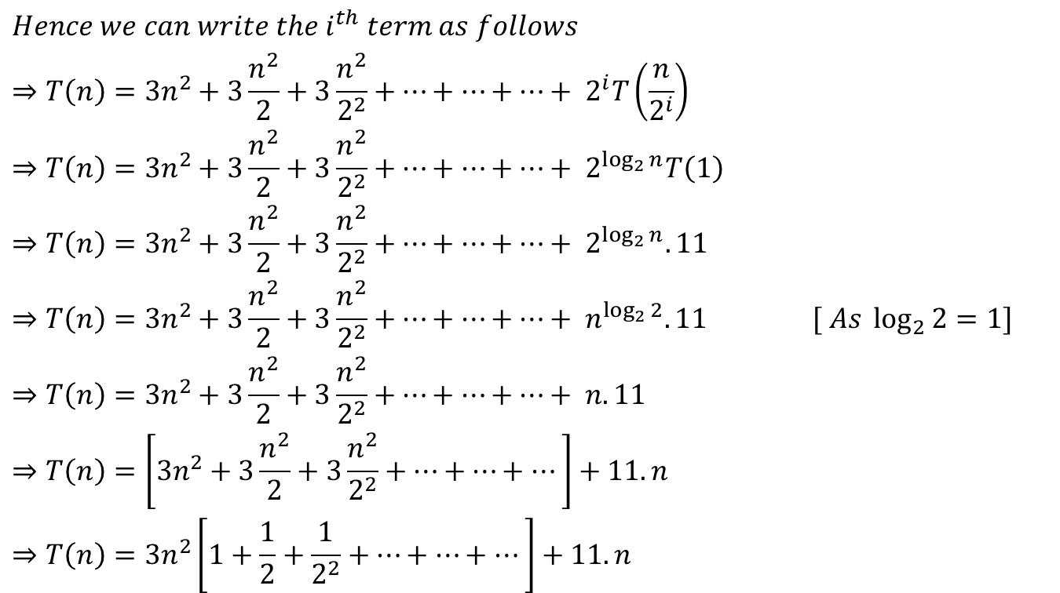
Iteration Method ( Example 2)
$$Hence we can write the i^{th} term as follows$$
$$⇒T\left(n\right)={3n}^{2}+3\frac{n^{2}}{2}+3\frac{n^{2}}{2^{2}}+…+…+…+ 2^{i}T\left(\frac{n}{2^{i}}\right)$$
$$⇒T\left(n\right)={3n}^{2}+3\frac{n^{2}}{2}+3\frac{n^{2}}{2^{2}}+…+…+…+ 2^{\log_{2}{n}}T\left(1\right)$$
$$⇒T\left(n\right)={3n}^{2}+3\frac{n^{2}}{2}+3\frac{n^{2}}{2^{2}}+…+…+…+ 2^{\log_{2}{n}}. 11$$
$$⇒T\left(n\right)={3n}^{2}+3\frac{n^{2}}{2}+3\frac{n^{2}}{2^{2}}+…+…+…+ n^{\log_{2}{2}}. 11 [ As \log_{2}{2}=1]$$
$$⇒T\left(n\right)={3n}^{2}+3\frac{n^{2}}{2}+3\frac{n^{2}}{2^{2}}+…+…+…+ n. 11$$
$$⇒T\left(n\right)=\left[{3n}^{2}+3\frac{n^{2}}{2}+3\frac{n^{2}}{2^{2}}+…+…+…\right]+11. n$$
$$⇒T\left(n\right)={3n}^{2}\left[1+\frac{1}{2}+\frac{1}{2^{2}}+…+…+…\right]+11. n$$

Slide 15
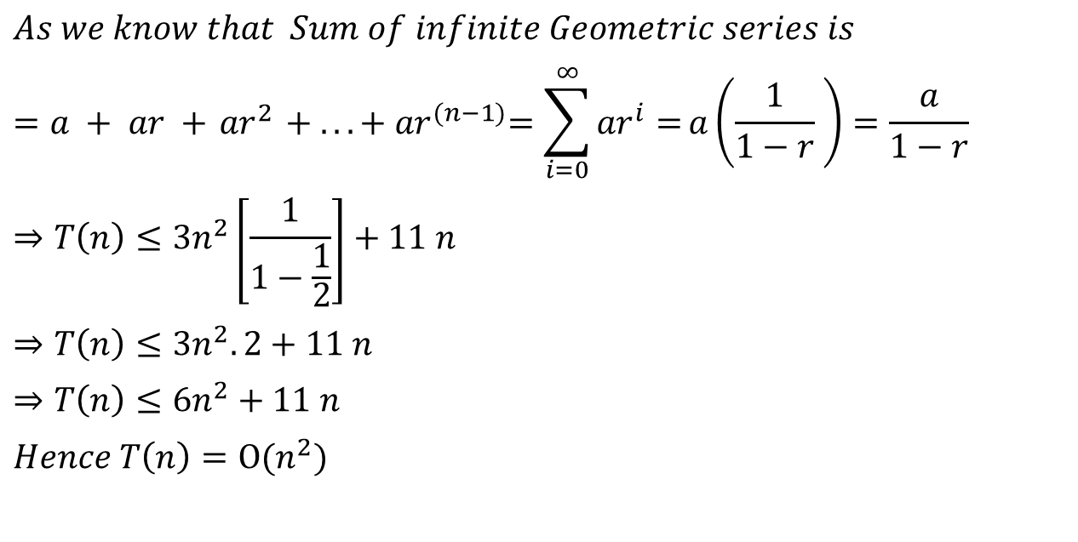
Iteration Method ( Example 2)
$$As we know that Sum of infinite Geometric series is$$
$$=a + ar +{ ar}^{2} + ... +{ ar}^{(n−1)}=\sum_{i=0}^{∞}{{ar}^{i}=}a\left(\frac{1}{1−r} \right)=\frac{a}{1−r}$$
$$⇒T\left(n\right)≤{3n}^{2}\left[\frac{1}{1−\frac{1}{2}}\right]+11 n$$
$$⇒T\left(n\right)≤{3n}^{2}.2+11 n$$
$$⇒T\left(n\right)≤{6n}^{2}+11 n$$
$$Hence T\left(n\right)=Ο(n^{2})$$

Slide 16

Iteration Method ( Example 3)
Example 3:
Solve the following recurrence relation by using Iteration method.
$$T\left(n\right)=\left\{\begin{matrix}8T\left(\frac{n}{2}\right)+n^{2} & if n>1 \\ 1 & if n=1\end{matrix}\right.$$

Slide 17
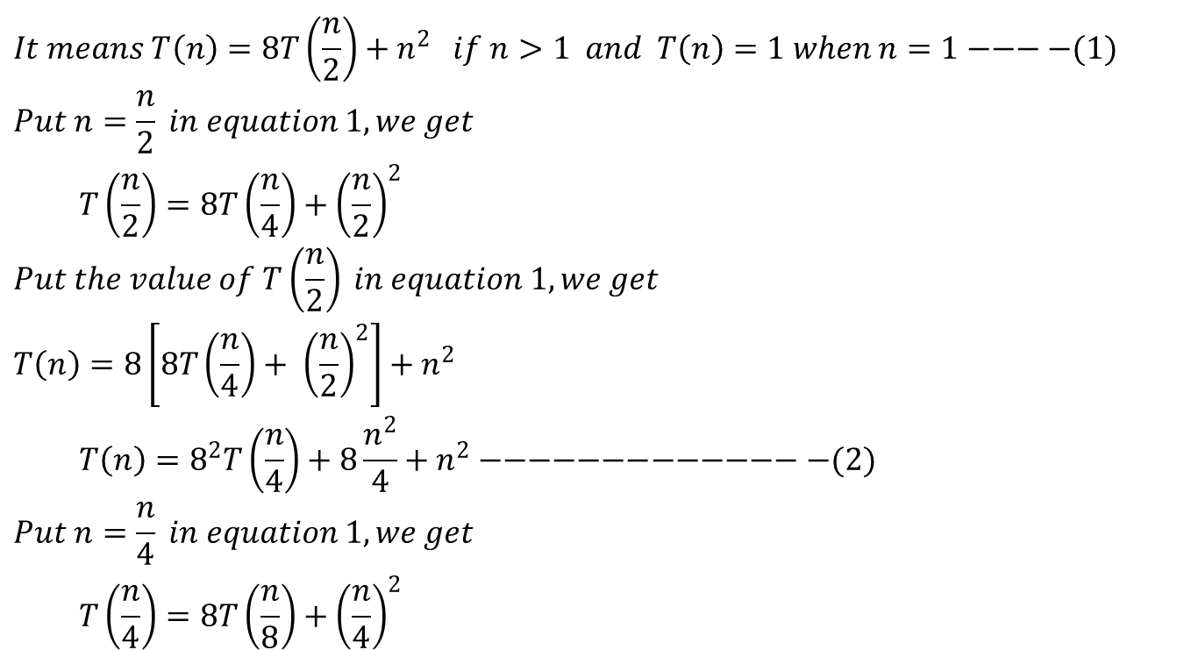
Iteration Method ( Example 3)
$$It means T\left(n\right)=8T\left(\frac{n}{2}\right)+n^{2} if n>1 and T\left(n\right)=1 when n=1−−−−(1)$$
$$Put n=\frac{n}{2} in equation 1, we get$$
$$T\left(\frac{n}{2}\right)=8T\left(\frac{n}{4}\right)+{\left(\frac{n}{2}\right)}^{2}$$
$$Put the value of T\left(\frac{n}{2}\right) in equation 1, we get$$
$$T\left(n\right)=8\left[8T\left(\frac{n}{4}\right)+ {\left(\frac{n}{2}\right)}^{2}\right]+n^{2}$$
$$T\left(n\right)=8^{2}T\left(\frac{n}{4}\right)+8\frac{n^{2}}{4}+n^{2}−−−−−−−−−−−−−−(2)$$
$$Put n=\frac{n}{4} in equation 1, we get$$
$$T\left(\frac{n}{4}\right)=8T\left(\frac{n}{8}\right)+{\left(\frac{n}{4}\right)}^{2}$$

Slide 18
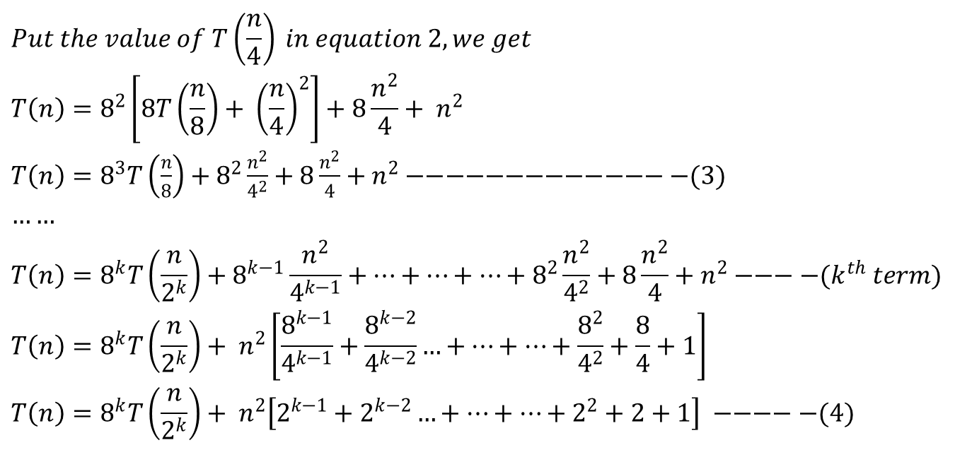
Iteration Method ( Example 3)
$$Put the value of T\left(\frac{n}{4}\right) in equation 2, we get$$
$$T\left(n\right)=8^{2}\left[8T\left(\frac{n}{8}\right)+ {\left(\frac{n}{4}\right)}^{2}\right]+8\frac{n^{2}}{4}+ n^{2}$$
$T\left(n\right)=8^{3}T\left(\frac{n}{8}\right)+8^{2}\frac{n^{2}}{4^{2}}+8\frac{n^{2}}{4}+n^{2}−−−−−−−−−−−−−−(3)$
$$……$$
$$T\left(n\right)=8^{k}T\left(\frac{n}{2^{k}}\right)+8^{k−1}\frac{n^{2}}{4^{k−1}}+…+…+…+8^{2}\frac{n^{2}}{4^{2}}+8\frac{n^{2}}{4}+n^{2}−−−−(k^{th} term)$$
$$T\left(n\right)=8^{k}T\left(\frac{n}{2^{k}}\right)+ n^{2}\left[\frac{8^{k−1}}{4^{k−1}}+\frac{8^{k−2}}{4^{k−2}}…+…+…+\frac{8^{2}}{4^{2}}+\frac{8}{4}+1\right]$$
$$T\left(n\right)=8^{k}T\left(\frac{n}{2^{k}}\right)+ n^{2}\left[2^{k−1}+2^{k−2}…+…+…+2^{2}+2+1\right] −−−−−(4)$$

Slide 19
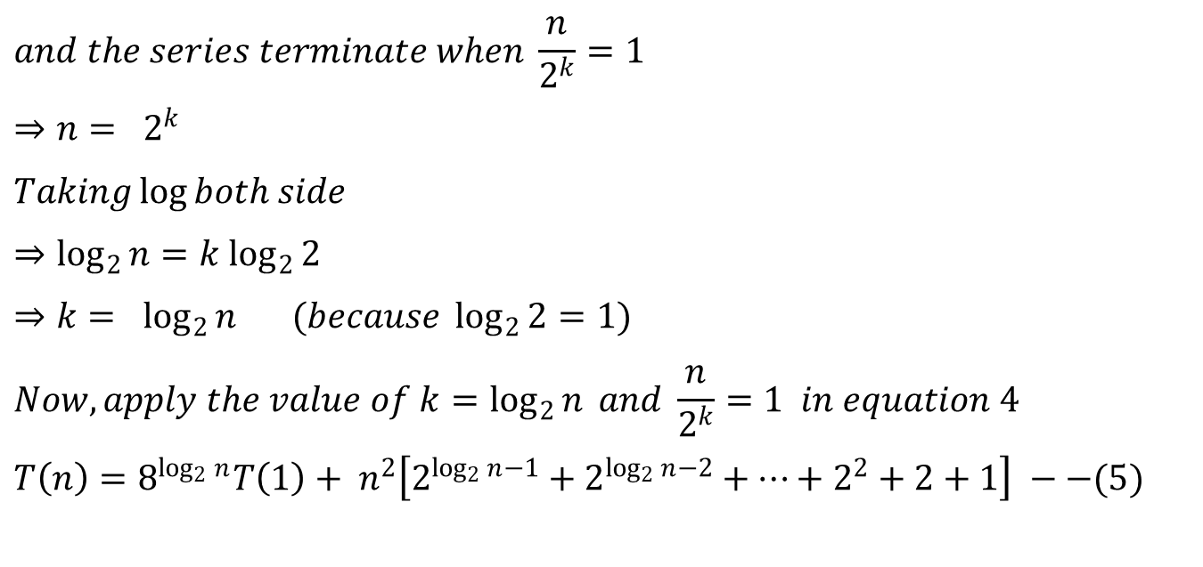
Iteration Method ( Example 3)
$$and the series terminate when \frac{n}{2^{k}}=1$$
$$⇒n= 2^{k}$$
$$Taking\log{both side}$$
$$⇒\log_{2}{n}=k \log_{2}{2}$$
$$⇒k= \log_{2}{n} (because \log_{2}{2}=1)$$
$$Now, apply the value of k=\log_{2}{n} and \frac{n}{2^{k}}=1 in equation 4$$
$$T\left(n\right)=8^{\log_{2}{n}}T\left(1\right)+ n^{2}\left[2^{\log_{2}{n}−1}+2^{\log_{2}{n}−2}+…+2^{2}+2+1\right] −−(5)$$

Slide 20
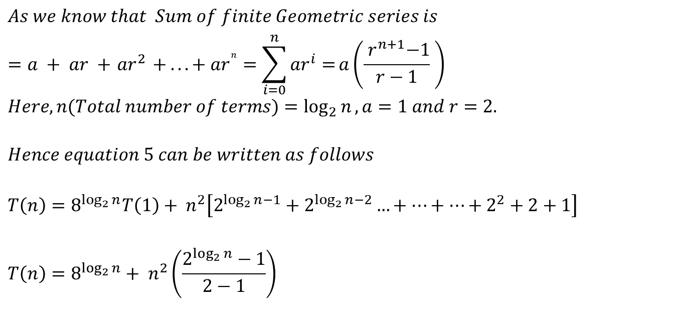
Iteration Method ( Example 3)
$$As we know that Sum of finite Geometric series is$$
$$=a + ar +{ ar}^{2} + ... + {ar}^{n}=\sum_{i=0}^{n}{{ar}^{i}=}a\left(\frac{{ r}^{n+1}−1}{r−1} \right)$$
$$Here, n(Total number of terms)=\log_{2}{n}, a=1 and r=2.$$
$$Hence equation 5 can be written as follows$$
$$T\left(n\right)=8^{\log_{2}{n}}T\left(1\right)+ n^{2}\left[2^{\log_{2}{n}−1}+2^{\log_{2}{n}−2}…+…+…+2^{2}+2+1\right]$$
$$T\left(n\right)=8^{\log_{2}{n}}+ n^{2}\left(\frac{2^{\log_{2}{n}}−1}{2−1}\right)$$

Slide 21
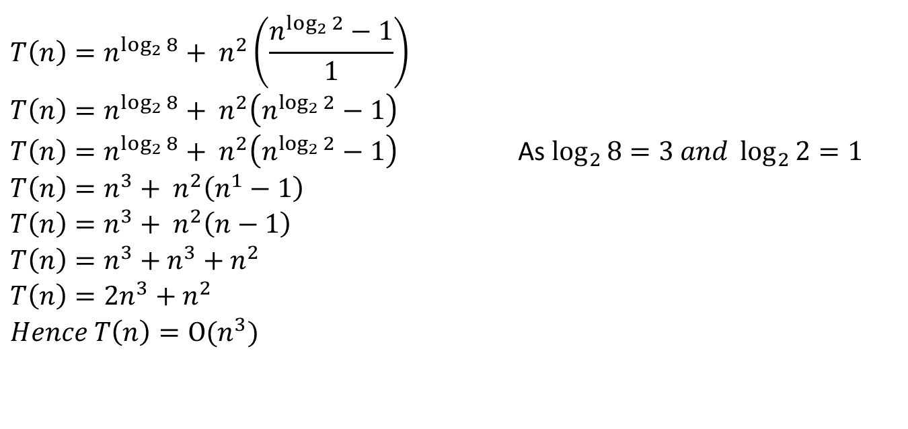
Iteration Method ( Example 3)
$$T\left(n\right)=n^{\log_{2}{8}}+ n^{2}\left(\frac{n^{\log_{2}{2}}−1}{1}\right)$$
$$T\left(n\right)=n^{\log_{2}{8}}+ n^{2}\left(n^{\log_{2}{2}}−1\right)$$
$T\left(n\right)=n^{\log_{2}{8}}+ n^{2}\left(n^{\log_{2}{2}}−1\right)$ As $\log_{2}{8}=3 and \log_{2}{2}=1$
$$T\left(n\right)=n^{3}+ n^{2}\left(n^{1}−1\right)$$
$$T\left(n\right)=n^{3}+ n^{2}\left(n−1\right)$$
$$T\left(n\right)=n^{3}+n^{3}+n^{2}$$
$$T\left(n\right)=2n^{3}+n^{2}$$
$$Hence T\left(n\right)=Ο(n^{3})$$

Slide 22

Iteration Method ( Example 4)
Example 4:
Solve the following recurrence relation by using Iteration method.
$$T\left(n\right)=\left\{\begin{matrix}7T\left(\frac{n}{2}\right)+n^{2} & if n>1 \\ 1 & if n=1\end{matrix}\right.$$
$$(i.e. Strassion Algorithm)$$

Slide 23
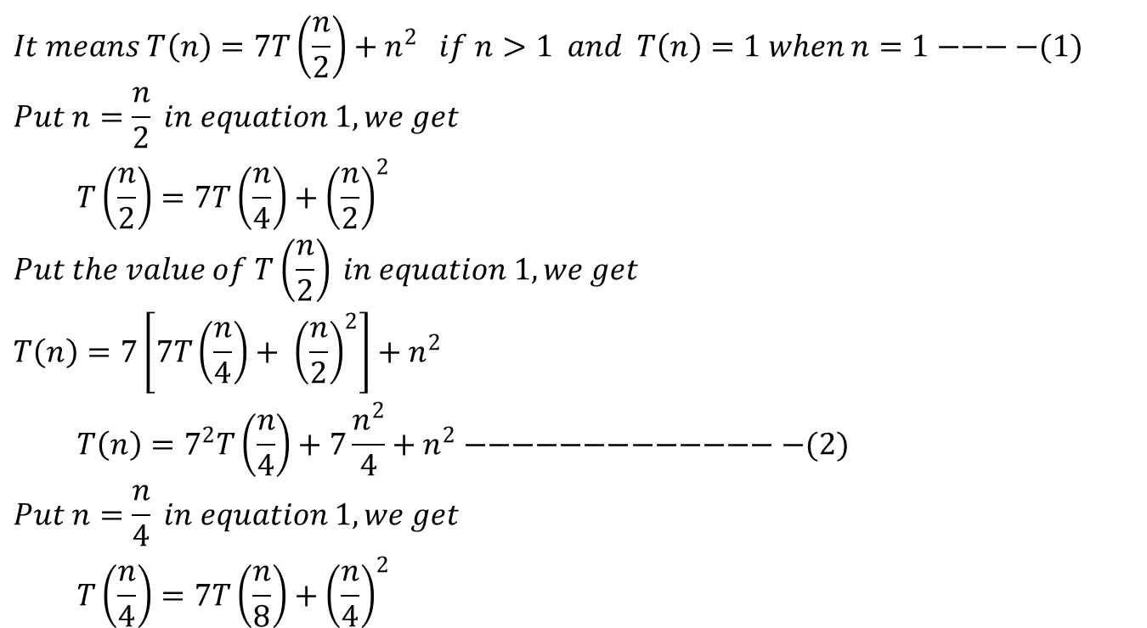
Iteration Method ( Example 4)
$$It means T\left(n\right)=7T\left(\frac{n}{2}\right)+n^{2} if n>1 and T\left(n\right)=1 when n=1−−−−(1)$$
$$Put n=\frac{n}{2} in equation 1, we get$$
$$T\left(\frac{n}{2}\right)=7T\left(\frac{n}{4}\right)+{\left(\frac{n}{2}\right)}^{2}$$
$$Put the value of T\left(\frac{n}{2}\right) in equation 1, we get$$
$$T\left(n\right)=7\left[7T\left(\frac{n}{4}\right)+ {\left(\frac{n}{2}\right)}^{2}\right]+n^{2}$$
$$T\left(n\right)=7^{2}T\left(\frac{n}{4}\right)+7\frac{n^{2}}{4}+n^{2}−−−−−−−−−−−−−−(2)$$
$$Put n=\frac{n}{4} in equation 1, we get$$
$$T\left(\frac{n}{4}\right)=7T\left(\frac{n}{8}\right)+{\left(\frac{n}{4}\right)}^{2}$$

Slide 24
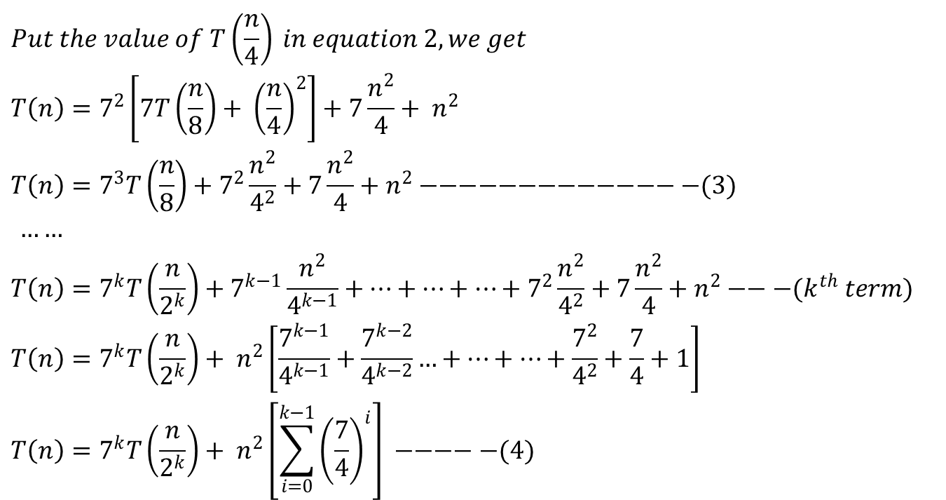
Iteration Method ( Example 4)
$$Put the value of T\left(\frac{n}{4}\right) in equation 2, we get$$
$$T\left(n\right)=7^{2}\left[7T\left(\frac{n}{8}\right)+ {\left(\frac{n}{4}\right)}^{2}\right]+7\frac{n^{2}}{4}+ n^{2}$$
$$T\left(n\right)=7^{3}T\left(\frac{n}{8}\right)+7^{2}\frac{n^{2}}{4^{2}}+7\frac{n^{2}}{4}+n^{2}−−−−−−−−−−−−−−(3)$$
$……$
$$T\left(n\right)=7^{k}T\left(\frac{n}{2^{k}}\right)+7^{k−1}\frac{n^{2}}{4^{k−1}}+…+…+…+7^{2}\frac{n^{2}}{4^{2}}+7\frac{n^{2}}{4}+n^{2}−−−(k^{th} term)$$
$$T\left(n\right)=7^{k}T\left(\frac{n}{2^{k}}\right)+ n^{2}\left[\frac{7^{k−1}}{4^{k−1}}+\frac{7^{k−2}}{4^{k−2}}…+…+…+\frac{7^{2}}{4^{2}}+\frac{7}{4}+1\right]$$
$$T\left(n\right)=7^{k}T\left(\frac{n}{2^{k}}\right)+ n^{2}\left[\sum_{i=0}^{k−1}{{\left(\frac{7}{4}\right)}^{i}}\right] −−−−−(4)$$

Slide 25
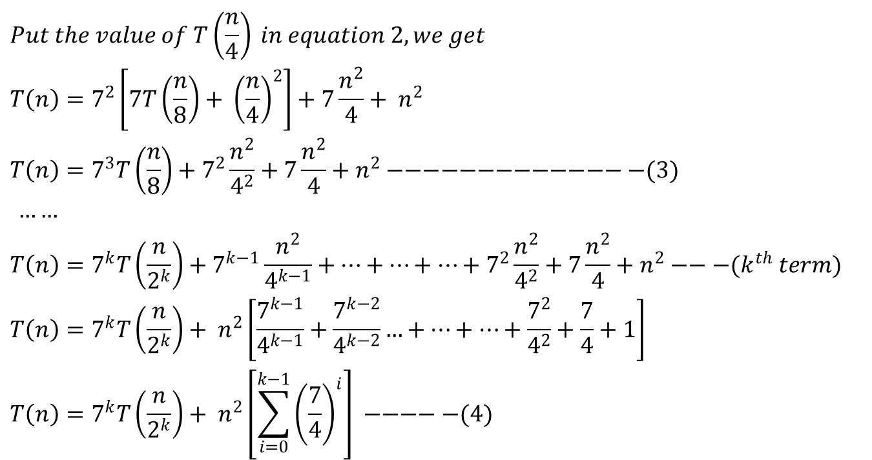
Iteration Method ( Example 4)
$$Put the value of T\left(\frac{n}{4}\right) in equation 2, we get$$
$$T\left(n\right)=7^{2}\left[7T\left(\frac{n}{8}\right)+ {\left(\frac{n}{4}\right)}^{2}\right]+7\frac{n^{2}}{4}+ n^{2}$$
$$T\left(n\right)=7^{3}T\left(\frac{n}{8}\right)+7^{2}\frac{n^{2}}{4^{2}}+7\frac{n^{2}}{4}+n^{2}−−−−−−−−−−−−−−(3)$$
$……$
$$T\left(n\right)=7^{k}T\left(\frac{n}{2^{k}}\right)+7^{k−1}\frac{n^{2}}{4^{k−1}}+…+…+…+7^{2}\frac{n^{2}}{4^{2}}+7\frac{n^{2}}{4}+n^{2}−−−(k^{th} term)$$
$$T\left(n\right)=7^{k}T\left(\frac{n}{2^{k}}\right)+ n^{2}\left[\frac{7^{k−1}}{4^{k−1}}+\frac{7^{k−2}}{4^{k−2}}…+…+…+\frac{7^{2}}{4^{2}}+\frac{7}{4}+1\right]$$
$$T\left(n\right)=7^{k}T\left(\frac{n}{2^{k}}\right)+ n^{2}\left[\sum_{i=0}^{k−1}{{\left(\frac{7}{4}\right)}^{i}}\right] −−−−−(4)$$

Slide 26
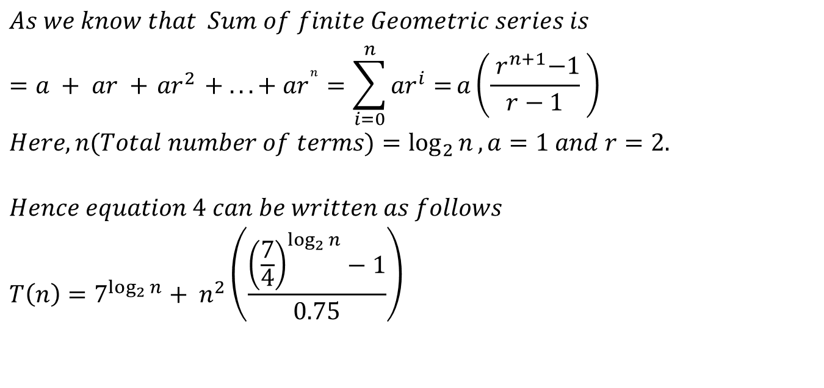
Iteration Method ( Example 4)
$$As we know that Sum of finite Geometric series is$$
$$=a + ar +{ ar}^{2} + ... + {ar}^{n}=\sum_{i=0}^{n}{{ar}^{i}=}a\left(\frac{{ r}^{n+1}−1}{r−1} \right)$$
$$Here, n(Total number of terms)=\log_{2}{n}, a=1 and r=2.$$
$$Hence equation 4 can be written as follows$$
$$T\left(n\right)=7^{\log_{2}{n}}+ n^{2}\left(\frac{{\left(\frac{7}{4}\right)}^{\log_{2}{n}}−1}{0.75}\right)$$

Slide 27
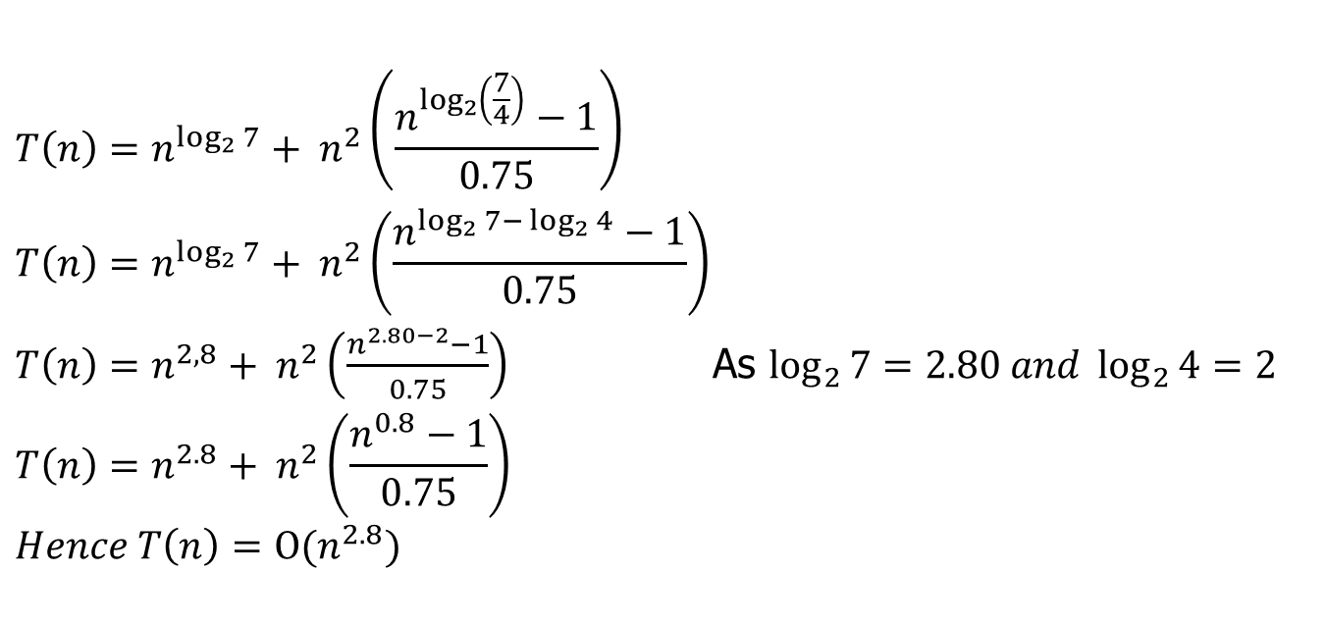
Iteration Method ( Example 4)
$$T\left(n\right)=n^{\log_{2}{7}}+ n^{2}\left(\frac{n^{\log_{2}\left(\frac{7}{4}\right)}−1}{0.75}\right)$$
$$T\left(n\right)=n^{\log_{2}{7}}+ n^{2}\left(\frac{n^{\log_{2}{7−}\log_{2}{4}}−1}{0.75}\right)$$
$T\left(n\right)=n^{2,8}+ n^{2}\left(\frac{n^{2.80−2}−1}{0.75}\right)$ As $\log_{2}{7}=2.80 and \log_{2}{4}=2$
$$T\left(n\right)=n^{2.8}+ n^{2}\left(\frac{n^{0.8}−1}{0.75}\right)$$
$Hence T\left(n\right)=Ο(n^{2.8})$

Slide 28
Recursion Tree Method

Slide 29
Recursion Tree Method

Slide 30
Recursion Tree Method

Slide 31

Thank U

